Slide 1
FreeBSD
It is NOT just for Breakfast anymore !
(Nor just for Servers either!!)

Slide 2
FreeBSD Myth
FreeBSD is awesome as a server, but you can’t use it as a desktop, let alone a daily driver

Slide 3
FreeBSD Myth #1
FreeBSD is awesome as a server, but you can’t use it as a desktop, let alone a daily driver
TRUTH- I have used FreeBSD as a desktop on and off since 1997, and as my home desktop for the last 5 years non-stop. And have it on 2 laptops.

Slide 4
FreeBSD Myth #2
FreeBSD doesn’t have all the applications that I use on Linux now

Slide 5
FreeBSD Myth #2
FreeBSD doesn’t have all the applications that I use on Linux now
TRUTH – Almost every application you can run on Linux has been ported to FreeBSD. There are a few exceptions, but 99+ % of the apps everyone uses today are on FreeBSD. Plus some (dtrace) that are FreeBSD only.

Slide 6
FreeBSD Myth #3
FreeBSD doesn’t have support for any desktop or laptop hardware, only supports servers

Slide 7
FreeBSD Myth #3
FreeBSD doesn’t have support for any desktop or laptop hardware, only supports servers
TRUTH – FreeBSD supports most hardware except the very latest hardware, such as this week’s newest video card. Supports most wireless and bluetooth cards, most video cards (yes even Nvidia)

Slide 8
Sources for the How-To
The following two websites I used extensively for some of the settings on how to tune FreeBSD to work on a desktop/laptop. My installs are a combination of these two methods
https://cooltrainer.org/a-freebsd-desktop-howto/
https://vermaden.wordpress.com/

Slide 9
Step 1
Install FreeBSD from USB Drive or CD/DVD
Might I suggest using ZFS as filesystem
If it is a laptop, I would encrypt the hard drive
On my github repo is a text document that walks you through installing FreeBSD to get the non-GUI portion installed.
https://github.com/bmac2/BSD-Meetup-Files

Slide 10
Steps for Configuration
Once you have the system installed and are logged in as root at the command prompt you should do the following things
  Install vim (pkg install vim) it will ask questions about installing pkg etc, answer yes to them all.
  Make sure you are up to date on your system by running (freebsd-update fetch, freebsd-update install)

Slide 11
Configure Language
You should set a default langage to make sure the fonts and system knows what to display text in. You do this by editing ‘/etc/login.conf’ and adding the following lines :
--- login.conf.default 2012-01-02 17:08:05.804291477 -0500
+++ login.conf 2012-01-02 17:08:16.996213774 -0500
@@ -44,7 +44,9 @@
\:pseudoterminals=unlimited:\
\:priority=0:\
\:ignoretime@:\
- \:umask=022:
+ \:umask=022:\
+ \:charset=UTF-8:\
+ \:lang=en_US.UTF-8:
now run cap_mkdb afterwards to update the system

Slide 12
Configure Language #2
Some login managers and some GUI applications need additional settings in the ‘/etc/profile’. Add the following two lines to the bottom of anything you have in there already
  LANG=en_US.UTF-8; export LANG
  CHARSET=UTF-8; export CHARSET

Slide 13
Desktop Tuning
The next item we need to configure on the sytem to allow us to have a pleasant desktop experience is the tuning of the process scheduler for desktop use. Edit the /etc/sysctl.conf to look like the following on the next slide:

Slide 14
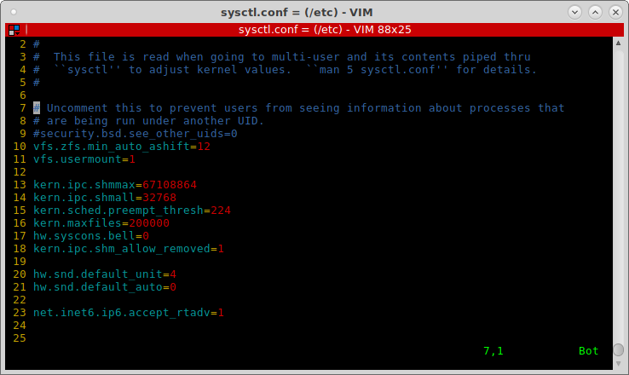
/etc/sysctl.conf

Slide 15
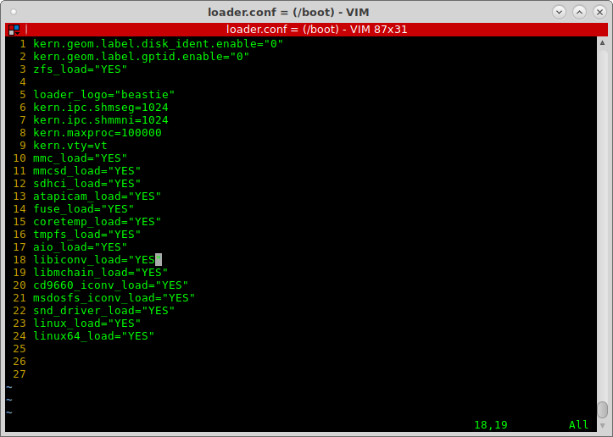
boot/loader.conf

Slide 16
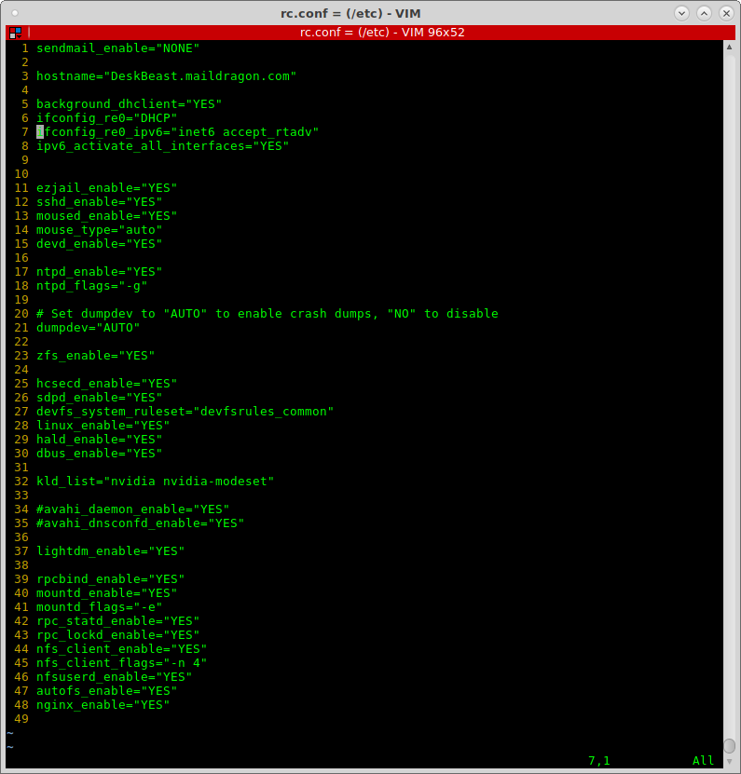

Slide 17
‘/etc/fstab’ Modifcations
In order for the linux compatibility and automounting of filesystems, I added the following lines to my fstab
  proc /proc procfs rw 0 0
  fdesc /dev/fd fdescfs rw,auto,late 0 0
  linprocfs /compat/linux/proc linprocfs rw 0 0
  linsysfs /compat/linux/sys linsysfs rw 0 0
  tmpfs /compat/linux/dev/shm tmpfs rw,mode=1777 0 0
  192.168.13.68:/mnt/Filestorage/Pictures /home/bmccormick/newpics nfs rw,proto=tcp,port=2049 0 0
  192.168.13.68:/mnt/Filestorage2/Music /home/bmccormick/newmusic nfs rw,proto=tcp,port=2049 0 0
  192.168.13.68:/mnt/Filestorage/Games /home/bmccormick/gameroms nfs rw,proto=tcp,port=2049 0 0
  192.168.13.68:/mnt/Filestorage/ebooks /home/bmccormick/ebooks nfs rw,proto=tcp,port=2049 0 0
  192.168.13.68:/mnt/Filestorage/files /home/bmccormick/myfiles nfs rw,proto=tcp,port=2049 0 0

Slide 18
User permissions
If for some reason your user account is not a member of the wheel and operator group, or if you don’t know, use the following command to check : id <username> i.e. id bmccormick
To add your user to a missing group do the following :
  pw group mod wheel -m bmccormick
  pw group mod operator -m bmccormick

Slide 19
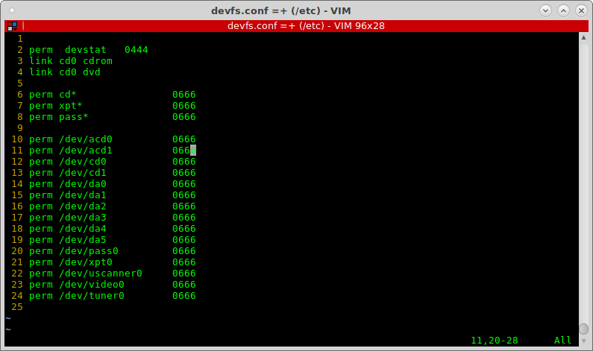
Device Enablement

Slide 20
Device Rules
Now that we created the devices, we need to create rules that will allow devices to be connected post-boot using the file /etc/devfs.rules.
(next slide for example)
We enabled this ruleset above in the rc.conf with the line: devfs_system_ruleset=”devfsrules_common”.

Slide 21
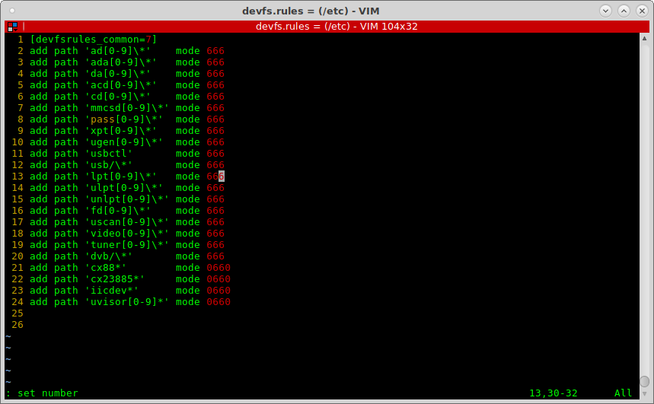
Device Rules (con’t)

Slide 22
Sound Configuration
Now in the sysctl.conf file above, we enabled a sound device. My sound device is on line 20, device number 4. Run the following command to determine the number of the sound device you want to enable:
# cat /dev/sndstat
go to line 20 of your sysctl.conf and put in your device number instead of my 4.

Slide 23
Networking (wired dhcp)
To enable wired networking run ifconfig and determine your network devices. On my desktop, my wired network controller is named re0. On my thinkpad laptop, it is named em0. Determine your device and use it in place of the re0 on the below /etc/rc.conf configuration. The first one is for a wired network with dhcp and autoconfigured ipv6:
hostname="deskbeast.maildragon.com"
# Enable DHCP for re0 and don't let dhclient block
background_dhclient="YES"
ifconfig_re0="DHCP"
ifconfig_re0_ipv6="inet6 accept_rtadv"

Slide 24
Networking (wired static)
The next example is for a wired network with a static ip address for both ipv4 and ipv6:
hostname="barrys-desktop.maildragon.com"
ifconfig_re0="inet 192.168.13.40 netmask 255.255.255.0 broadcast 192.168.13.255"
defaultrouter="192.168.13.1"
ifconfig_re0_ipv6="inet6 2001:370:10f5:806::40 prefixlen 64"
ipv6_defaultrouter="2001:370:10f5:806::1"

Slide 25
Networking (wireless)
And the 3rd example is how to configure rc.conf for your wireless connection so it connects at boot time:
/etc/rc.conf
wlans_run0="wlan0"
ifconfig_wlan0="ssid HomeFront WPA DHCP"
/etc/wpa_supplicant.conf
network={
ssid="PimpDaddyWireless"
psk="MySillyPasswordYouCantGuess!"
}
network={
ssid="SlaveDriversInc"
psk="TheirSillyPasswordYouCantGuess!"

Slide 26
PKG or PORTS ???
Before you start installing packages y ou need to make sure your packages are up to date. Run “pkg update” to make absolutely certain your list of packages is up to date.
In step one I had you install vim using “pkg install vim”. That is the format for installing all packages, “pkg install packagename”. If you don’t know the exact packag you want, say for example you want to find all packages with the word nvidia inside the package name, use the following command: “pkg search nvidia” Below is an example of where I ran it on my desktop:

Slide 27
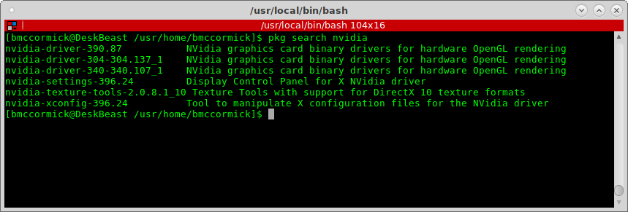
PKG or Ports ?? (con’t)

Slide 28
Going Graphical
( or how to spice up that ugly command line!!)
First we must install the X11/xorg package. This is the base xwindows server that is currently used by FreeBSD. You install it by running
# pkg install xorg
This will install 120 packages on your system to configure everything needed for a bare xserver to run, but with no frills and no fancy window managers. Just the good old Tab Window Manager in all its plain-jane glory.

Slide 29
Fonts
you should install some additional fonts to make your programs look better. The fonts installed by default in the xorg install are not very attractive. For english users install the following fonts:
  pkg install x11-fonts/anonymous-pro x11-fonts/artwiz-aleczapka x11-fonts/dejavu x11-fonts/inconsolata-ttf x11-fonts/terminus-font x11-fonts/cantarell-fonts x11-fonts/droid-fonts-ttf x11-fonts/doulos x11-fonts/ubuntu-font x11-fonts/stix-fonts

Slide 30
X11-Webfonts
One additional font set you will want is the x11-fonts/webfonts. It includes the Microsoft Core Fonts for the Web. To install this you need to create an /etc/make.conf file with the following content before installing it:
/etc/make.conf
# Enable Tahoma in x11-fonts/webfonts if you have a Windows license
# You show me yours and I'll show you mine ;)
.if ${.CURDIR:M*/x11-fonts/webfonts}
WITH_MSWINDOWS_LICENSE=yes
.endif
Once this is done run “pkg install x11-fonts/webfonts” to install it.

Slide 31
Test System
Reboot computer
Log in as your normal user
Run ‘startx’. If it gives you two xterm windows, and a login window in beautiful white with green borders and an awsome non-digital clock, you have successfully installed xorg and it is runing on your machine. Now, this does not have any video specific drivers on it, but it is fully functional. Hit ctl-alt-F1 to go back to the first tty and hit ctl-C to kill the xwindow session.
If not review the docs to determine what is wrong.

Slide 32
Window Managers
Lumina
Mate
Window Maker
OpenBox
KDE
Gnome2
Gnome3
TWM
Enlightenment
XFCE
Cinnamon
IceWM
OpenBOX
DWM (rating of 91 on slant.com)
I3 (rating of 96 on slant.com)
There are 138 Window managers in the ports of FreeBSD

Slide 33
Display Managers
Slim – lightweight, available everywhere, not tied to one specific WM
LightDM
GDM
KDM
XDM

Slide 34
Printing
You should use the CUPS printing package to print from your desktop. Run the following command to install CUPS and its packages:
pkg install cups hplip foomatic-filters foomatic-db foomatic-db-engine cups-pdf
Now that those are installed you need to configure a couple of lines additionally in your rc.conf file. Add the following to the bottom of that file:
# Disable line printer daemon since we have CUPS
lpd_enable="NO"
# Enable CUPS
cupsd_enable="YES"
The last part of printing is adding your normal user and root to the cups group so you can print. Run the following:
pw group mod cups -m bmccormick
pw group mod cups -m root
Once you reboot you should be able to get to the web configuration of cups at http://localhost:631/ in a browser.

Slide 35
WebCams
Most usb cameras and cameras built into your laptop are supported by the webcamd driver, and depends on the cuse4bsd-kmod module. Install them both by running:
pkg install webcamd cuse4bsd-kmod cheese pwcview
Once this is done add the following line to your /etc/rc.conf file:
webcamd_enable=”YES”
Add the following line to your /boot/loader.conf file:
cuse4bsd_load=”YES”
Then run the following command to allow your normal user to access the camera:
pw group mod webcamd -m bmccormick

Slide 36
Java
You need to install java for many applications. Run “pkg install openjdk8” to install Java version 1.8 to your system.

Slide 37
Nvidia
If you have an nvidia video card determine which version of the nvidia driver is needed for your card. I need the 304 version of the driver, so I run the following command:
pkg install nvidia-driver-304 nvidia-settings
Then you must enable the driver in your /boot/loader.conf by adding the following line:
nvidia_load=”YES”

Slide 38
Programs
Install the best terminal for *nix out there with “pkg install terminator”
Install a password manager with “pkg install keepass”
Install firefox with “pkg install firefox”
Install libreoffice with “pkg install libreoffice”
Install Sublime programming editor with “pkg install linux-sublime3”

Slide 39
Programs (con’t)
To rip CDs to flac or mps install grip with “pkg install asunder” (grip is broken and no longer maintained)
Install Conky to have a desktop system status package with “pkg install conky”
Install vlc for playing media with “pkg install vlc”
Install Rythmbox music player with “pkg install rythmbox”
Install cd burning application with “pkg install xfburn”
Install audio editing software with “pkg install audacity”

Slide 40
Programs (con’t)
Install evolution mail client with “pkg install evolution”
Install an irc client with “pkg install hexchat”
Install pidgin instant messaging with “pkg install pidgin”
Install a torrent client with “pkg install deluge”
Install needed admin tools with “pkg install sudo doas”

Slide 41
Speed up Boot Time
Add the following two lines to ‘/boot/loader.conf’
  boot_mute=YES
  autoboot_delay=2
If you really want to tune, go to the following page and read all the possible steps :
https://vermaden.wordpress.com/2018/03/29/freebsd-desktop-part-1-simplified-boot/

Slide 42
Shameless Plug – DevOps Days
Noah’ Event Center
MAY 14 -15
https://www.slcdevopsdays.org
$149 this month
$199 afterward
15 % discount code :
MeetupSLCDOD2019

Slide 43
Any Questions ?
If you need help configuring, let me know. Always on
https://chat.bastillebsd.org/bastille/
Or usually on IRC on Freenode.net bmac2 or bmac666, in #DC801 and #linuxmce
Install fest on a weekend ????

